Slide 1
Collusion-Resistant
Worker Set Selection for
Transparent and Verifiable
Blockchain-Based Voting
Matthieu BETTINGER
Lucas BARBERO
Omar Hasan

Slide 2
Context

Slide 3
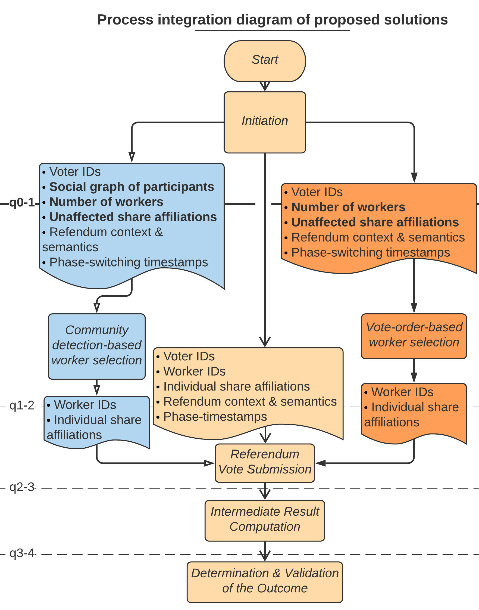
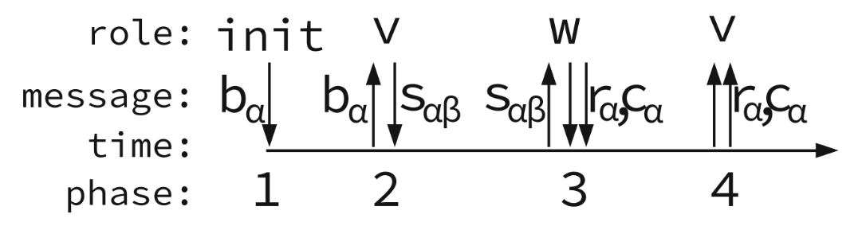
Process
1
Schiedermeier et al. (2019)
2
3
4
Bettinger et al. (2021)

Slide 4
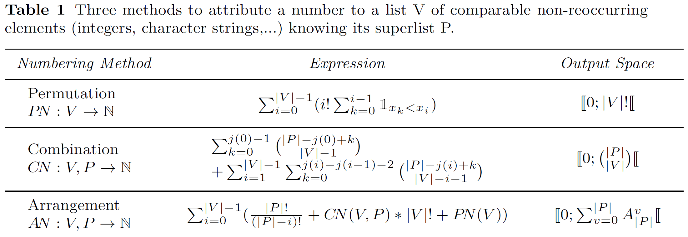
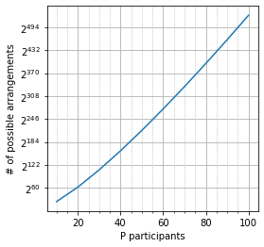
Verifiable random number generation
PN : Ordering of V voters
CN : Which subset of V participants voted
AN : PN & CN + Sum(AN with fewer voters)
  10 participants : 10⁶ possibilities
  100 participants : 10¹⁵⁸ possibilities

Slide 5
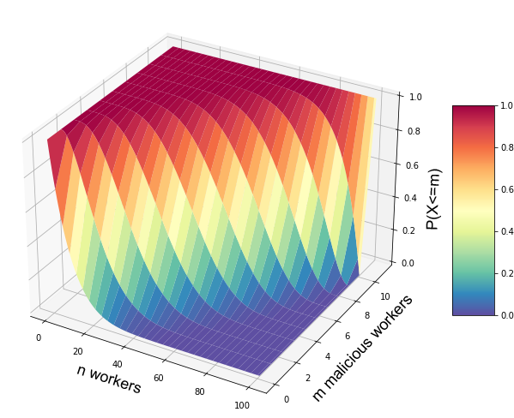
Probability Distribution
Hypergeometric Law
H(n, M/P, P)
  P participants
  M ≤ P malicious participants
  n workers
  m malicious workers
P=100 M=10

Slide 6
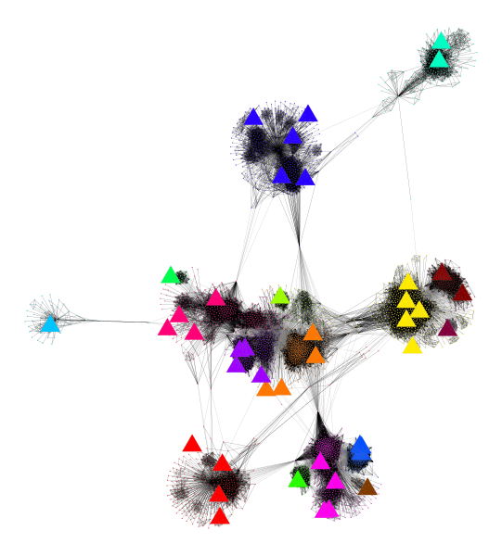
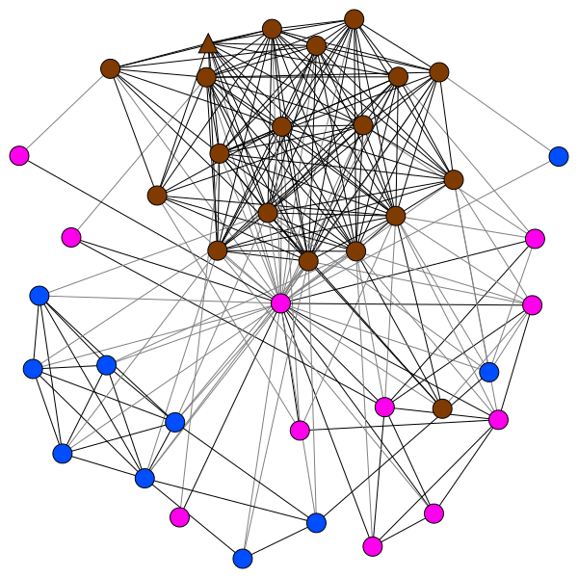
Worker distancing

Slide 7
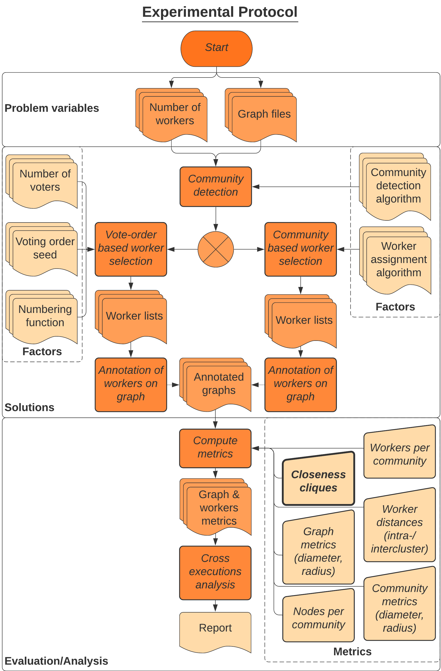

Slide 8
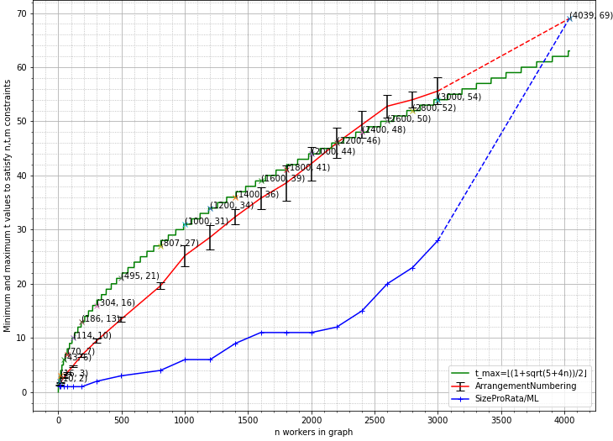
Cliques of adjacent workers

Slide 9
Application to iExec’s worker selection

Slide 10
Application to iExec’s worker selection
Aral et al. (2020)

Slide 11
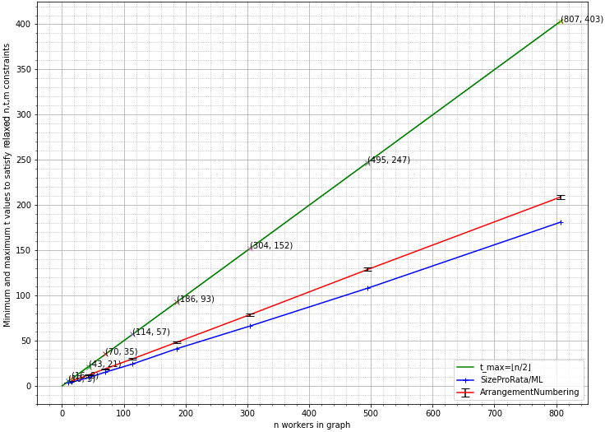
Cliques of workers distant of at most 2

Slide 12
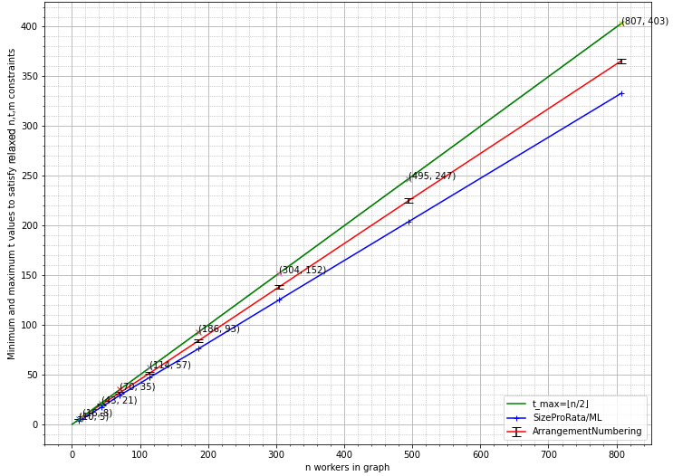
Cliques of workers distant of at most 3

